Slide 1
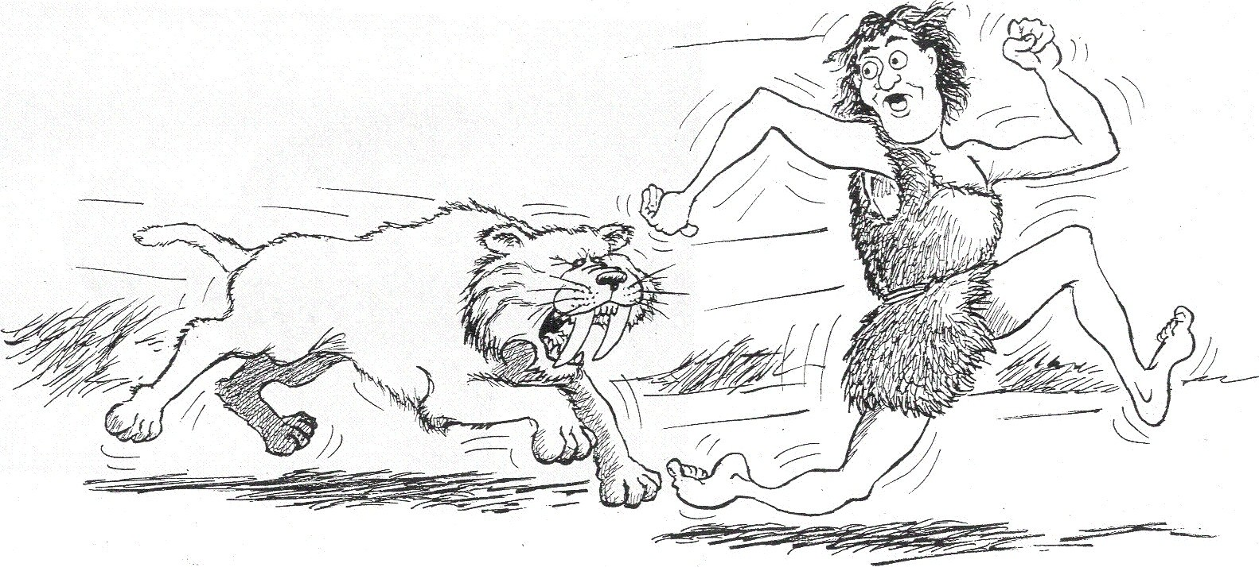
Introducing…
The Stress Response & Fight or Flight

Slide 2
Types of Stress
Chronic:
  Unrelieved stress that continues to tax a person’s resources to the point of exhaustion; stress that is damaging to health
Acute:
  Temporary bout of stress that calls forth alertness or alarm to prompt the person to deal with an event

Slide 3

Eustress Distress
-

Slide 4
Stress Response
The response to a demand or stressor, which has three phases: alarm, resistance, and recovery or exhaustion

Slide 5
Stress Response Stages
Alarm:
  First reaction to stress – recognizes danger
  Activates the nerves and all systems
Resistance:
  Body mobilizes its resources to withstand the effects of stress
    Hormones continue throughout body
    Muscles contract and body functions shut down

Slide 6
Stress Response Stages
3) Recovery: (healthy)
  Hormone Levels drop to normal
  Body systems slow down
  Muscles relax, blood flows to all body parts
Exhaustion: (harmful)
  Stress exceeds the body’s ability to recover
  Recovery is delayed or becomes impossible

Slide 7
Fight or Flight Response
The body is preparing to act physically
Occurs in alarm stage
> Heart rate speeds up
> Pupils dilate
> Muscles tense (ready to jump or struggle)
> Fuels are released
> Blood flow to muscles and brain increase
> Blood flow to skin reduces (in case of injury)
> Immune system temporarily shuts down
Fight or Flight?

